Slide 1
Salt Partners
Analysing global salt supply developments
Vladimir M. Sedivy MSc (Hons) Chem Eng, IMD President Salt Partners Ltd, Zurich, Switzerland

Slide 2
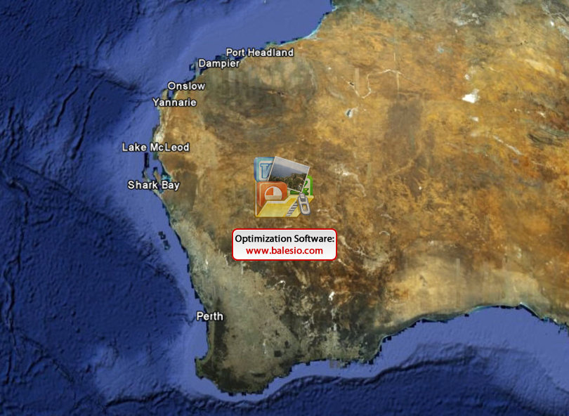
Salt Partners
Flight over Australian Saltfields
Vladimir M. Sedivy
Salt Partners Ltd, Zurich, Switzerland
Salt Partners flew over some of the world largest solar saltfields. Isabella Sedivy was shooting pictures.
GOOGLE EARTH

Slide 3
Salt Partners
Shark Bay Salt Stockpiles
The Shark Bay stockpiles are 200m long and 60m wide. Their design capacity is 250’000 t. They were less than half full.
Vladimir M. Sedivy
Salt Partners Ltd, Zurich, Switzerland
SALT PARTNERS

Slide 4
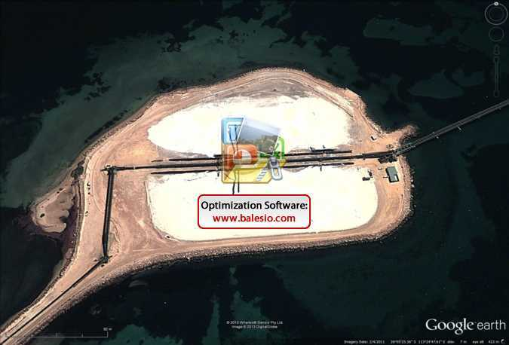
Salt Partners
Shark Bay Salt Stockpiles
Vladimir M. Sedivy
Salt Partners Ltd, Zurich, Switzerland
In early 2003, viewed on Google Earth, the Shark Bay stockpiles were still about half full.

Slide 5
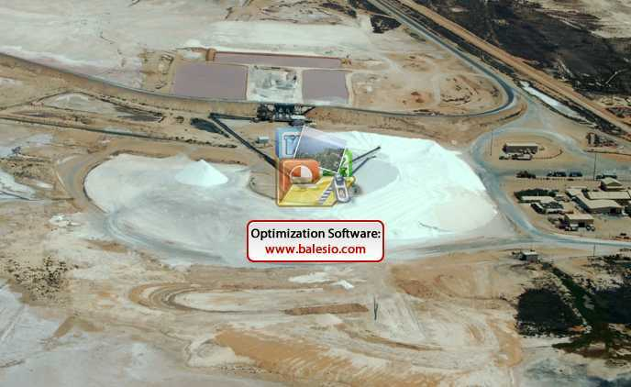
Salt Partners
Lake McLeod Salt Stockpile
At Lake McLeod, the stockpile next to the wash plant has a design capacity of 1’500’000 t. It was about 12% full.
Vladimir M. Sedivy
Salt Partners Ltd, Zurich, Switzerland
SALT PARTNERS

Slide 6
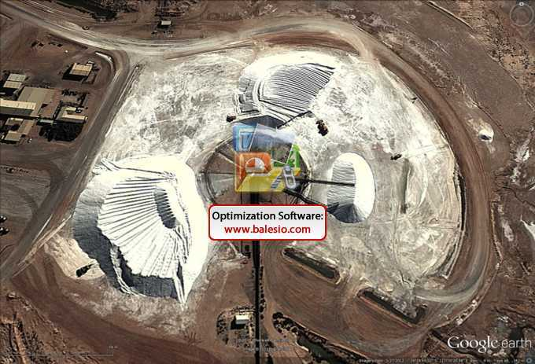
Salt Partners
Lake McLeod Salt Stockpile
Vladimir M. Sedivy
Salt Partners Ltd, Zurich, Switzerland
Also the Lake McLeod stockpile pictured in 2013 didn’t show much change.

Slide 7
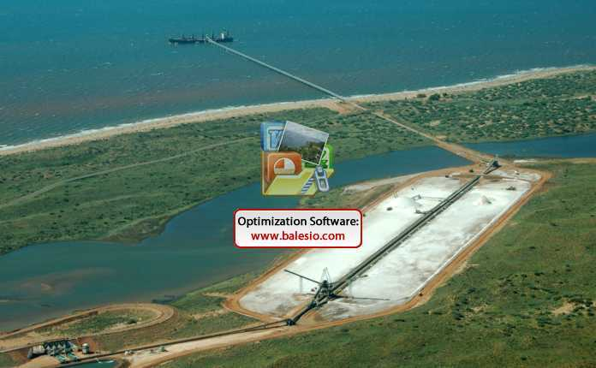
Salt Partners
Onslow Salt Stockpile
Onslow stockpile was designed for 500‘000 t of salt. On 2.2.2009, there was virtually no salt left. The picture shows the shipment of last salt from Onslow stockpile.
Vladimir M. Sedivy
Salt Partners Ltd, Zurich, Switzerland
SALT PARTNERS

Slide 8
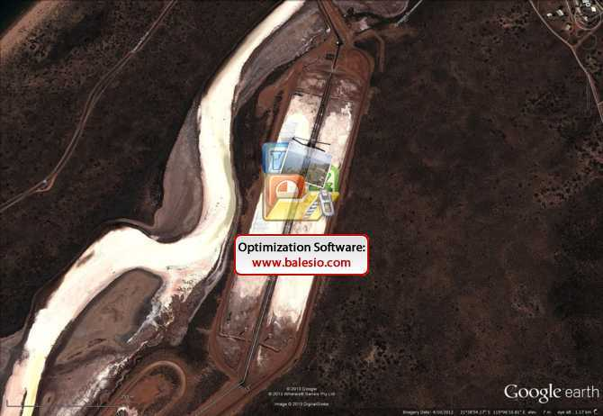
Salt Partners
Onslow Salt Stockpile
Vladimir M. Sedivy
Salt Partners Ltd, Zurich, Switzerland
This Google Earth image from 2013 shows Onslow stockpile about 20% full.

Slide 9
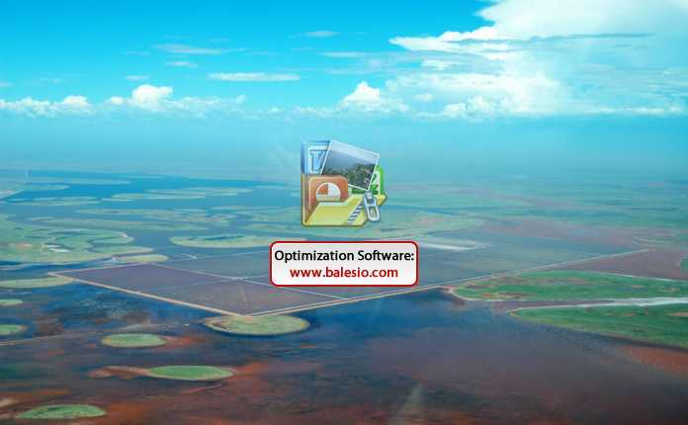
Salt Partners
Onslow Crystallisers
Vladimir M. Sedivy
Salt Partners Ltd, Zurich, Switzerland
On 27.1.2009 the Onslow saltworks were flooded by cyclone Dominic.
SALT PARTNERS

Slide 10
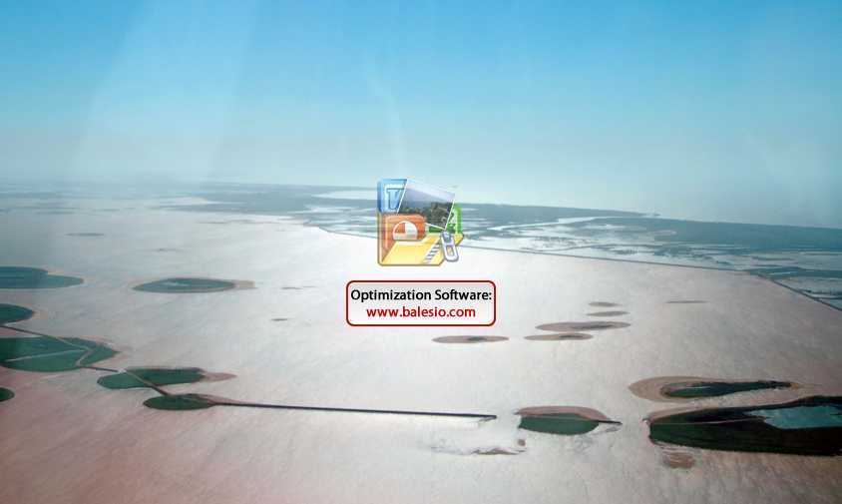
Salt Partners
Onslow Brine Pond No. 1
Onslow brine pond one week after it was hit by the cyclone Dominic. The dikes were broken through at three locations. Brine was flowing out, to the sea. It took many months to restore full production.
Vladimir M. Sedivy
Salt Partners Ltd, Zurich, Switzerland
SALT PARTNERS

Slide 11
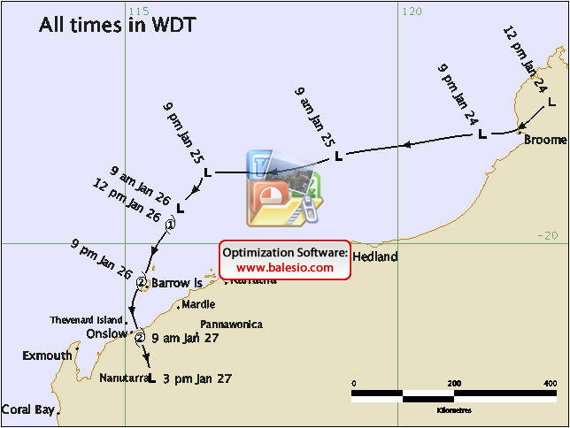
Salt Partners
Tropical Cyclone Dominic
The Onslow saltfield was hit by tropical cyclone Dominic on 27.1.2009. Dominic was a moderate, category 2 cyclone with wind gust 140 km/h and 240 mm rainfall.
Vladimir M. Sedivy
Salt Partners Ltd, Zurich, Switzerland
Australian Bureau of Meteorology

Slide 12
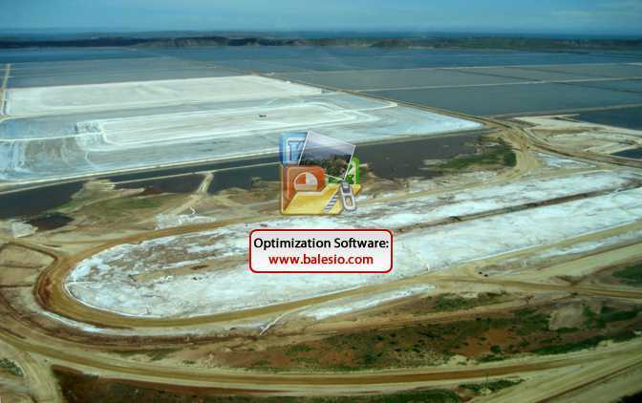
Salt Partners
Dampier Original Drying Stockpile
At Dampier, the original drying stockpile was designed for up to 2’000’000 t. It is not being used any more. Harvested salt is hauled to the new washing plant near the sea shore.
Vladimir M. Sedivy
Salt Partners Ltd, Zurich, Switzerland
SALT PARTNERS

Slide 13
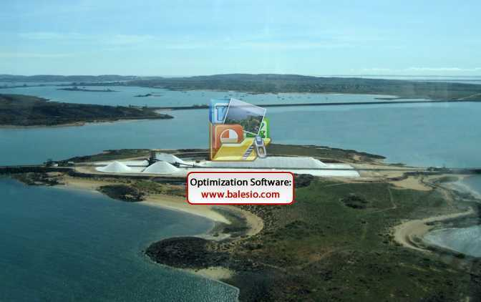
Salt Partners
Dampier Original Intermediate Stockpile
The two Dampier original intermediate stockpiles are now used to dry the salt washed in a new washing plant. They are 400 m long and 55 m wide. They can hold up to 500’000 t. The pictured stock is estimated at about 170’000 t or 36% of design capacity.
Vladimir M. Sedivy
Salt Partners Ltd, Zurich, Switzerland
SALT PARTNERS

Slide 14
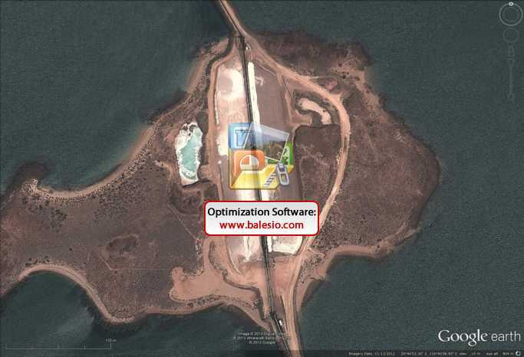
Salt Partners
Dampier Original Intermediate Stockpile
Vladimir M. Sedivy
Salt Partners Ltd, Zurich, Switzerland
The Google Earth image from 2013 shows only about 35% of the Dampier intermediate stockpile to hold salt.

Slide 15
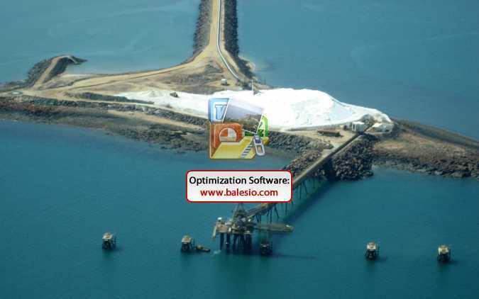
Salt Partners
Dampier Shipping Stockpile
Dampier shipping stockpile could hold more than 250’000 t. The picture shows less than100’000 t of salt ready for shipment.
Vladimir M. Sedivy
Salt Partners Ltd, Zurich, Switzerland
SALT PARTNERS

Slide 16
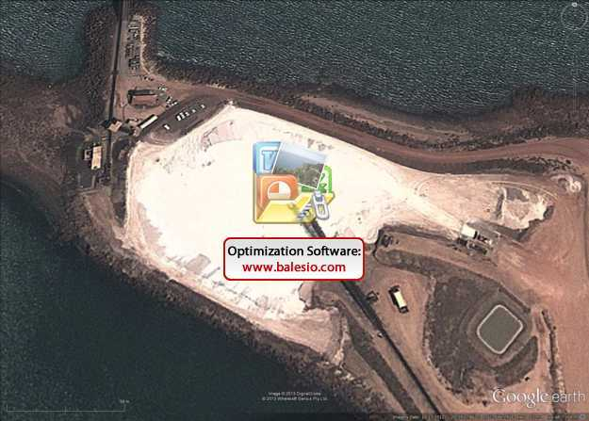
Salt Partners
Dampier Shipping Stockpile
Vladimir M. Sedivy
Salt Partners Ltd, Zurich, Switzerland
This 2013 Google Earth image shows unchanged situation at the Dampier salt shipping stockpile.

Slide 17
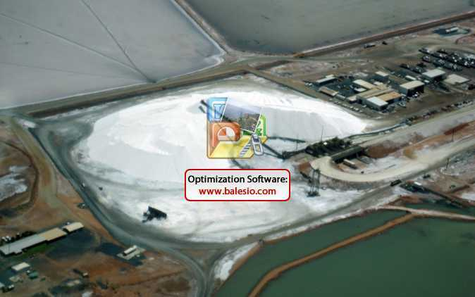
Salt Partners
Port Headland Stockpiles
Port Headland stockpiles are large enough to hold about 1’400’000 t. In February 2009, they were less than 60% full.
Vladimir M. Sedivy
Salt Partners Ltd, Zurich, Switzerland
SALT PARTNERS

Slide 18
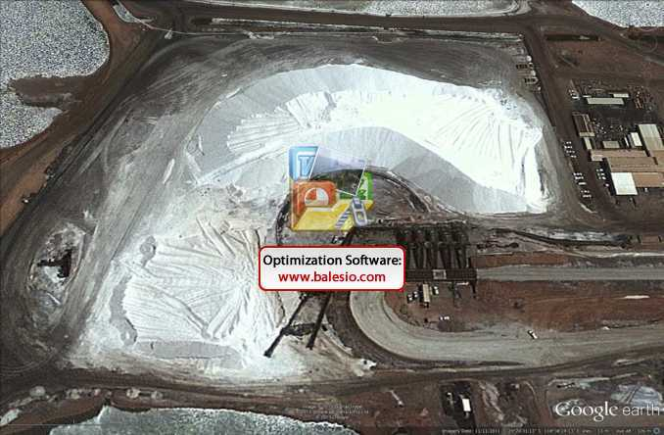
Salt Partners
Port Headland Stockpiles
Vladimir M. Sedivy
Salt Partners Ltd, Zurich, Switzerland
This 2013 Google Earth image shows Port Headland stockpile to be about 40% full.

Slide 19
Salt Partners
Australian Salt Stockpiles in February 2009
Salt Producer | Stockpile | Stockpile Capacity | Salt on Stock | Percent Full
 |  | (t) | (t) | (%)
Shark Bay |  | 275‘000 | 133‘000 | 48%
Onslow |  | 652‘000 | 1‘000 | 0%
McLeod | Drying | 1'520‘000 | 180‘000 | 12%
 | Shipping | 267‘000 | 7‘000 | 3%
Dampier | Drying | 1'896‘000 | 0 | 0%
 | Intermediate | 475‘000 | 169‘000 | 36%
 | Shipping | 264‘000 | 96‘000 | 36%
Port Headland | Drying | 999‘000 | 567‘000 | 57%
 | Shipping | 384‘000 | 199‘000 | 52%
Total |  | 6'732‘000 | 1'352'000 | 20%
Vladimir M. Sedivy
Salt Partners Ltd, Zurich, Switzerland
SALT PARTNERS

Slide 20
Salt Partners
Australian Salt Production Capacity and Design Stockpiling Capacity
Salt Producer | Production Capacity | Stockpiling Capacity | Percent
 | (t/y) | (t) | (%)
Shark Bay | 2’200’000 | 275’000 | 13%
Onslow | 2’500’000 | 653’000 | 26%
McLeod | 2’300’000 | 1’787’000 | 78%
Dampier | 4’000’000 | 2’635’000 | 66%
Port Headland | 3’500’000 | 1’384’000 | 40%
Total | 14’500’000 | 6’734’000 | 46%
Vladimir M. Sedivy
Salt Partners Ltd, Zurich, Switzerland
SALT PARTNERS

Slide 21
Salt Partners
Australian Salt Production Capacity and Salt on Stockpile
Salt Producer | Production Capacity | Salt on Stockpile | Percent
 | (t/y) | (t) | (%)
Shark Bay | 2’200’000 | 133’000 | 6%
Onslow | 2’500’000 | 1’000 | 0%
McLeod | 2’300’000 | 187’000 | 8%
Dampier | 4’000’000 | 264’000 | 7%
Port Headland | 3’500’000 | 765’000 | 2%
Total | 14’500’000 | 1’352’000 | 9%
Vladimir M. Sedivy
Salt Partners Ltd, Zurich, Switzerland
SALT PARTNERS

Slide 22
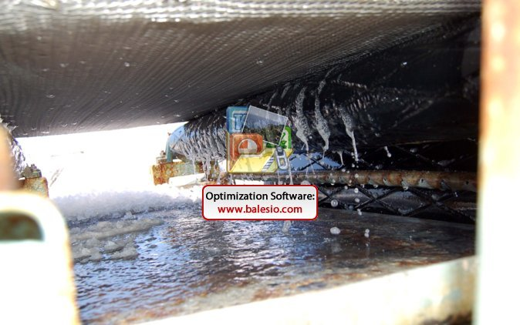
Salt Partners
Drip-off Belts
Most Australian wash plants employ drip-off belts. This picture shows that at the end of such belt, the salt is still dripping wet.
Vladimir M. Sedivy
Salt Partners Ltd, Zurich, Switzerland
SALT PARTNERS

Slide 23
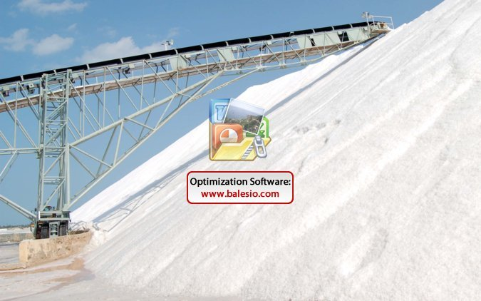
Salt Partners
Salt Drying on Stockpiles
Vladimir M. Sedivy
Salt Partners Ltd, Zurich, Switzerland
Drip-dried salt is wet when stockpiled. The brine flows slowly to the ground and out of the stockpile (see bottom left).
SALT PARTNERS

Slide 24
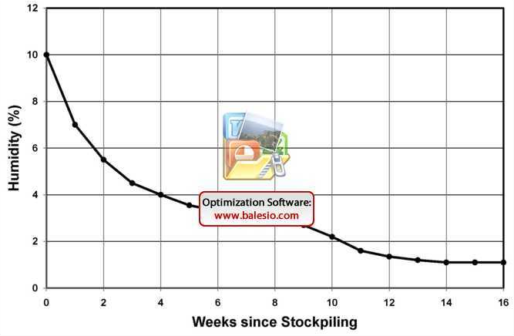
Salt Partners
Salt on Stockpile, Humidity vs. Time
Magnesium salts are hygroscopic. They absorb moisture from the air. The brine so formed dilutes the magnesium. As long as the salt is more than 3% humid, the brine flows with the magnesium out of the stockpile. After the magnesium is removed, the salt can dry up. The drying process takes about 3 months.
Vladimir M. Sedivy
Salt Partners Ltd, Zurich, Switzerland
SALT PARTNERS

Slide 25
Salt Partners
Residual Magnesium in Salt after Washing
Magnesium in bitterns: 2.64%
Magnesium in 10% humid salt after harvest: 0.26%
Magnesium in sea water: 0.14%
Standard magnesium content in salt: 0.02%
Washing with sea water | Magnesium in 10% humid salt | Magnesium in 2.5% humid salt | Salt losses by dissolution
(l/t of salt) | (%) | (%) | (%)
100 | 0.139 | 0.035 | 3
200 | 0.097 | 0.024 | 7
300 | 0.076 | 0.019 | 10
Vladimir M. Sedivy
Salt Partners Ltd, Zurich, Switzerland
SALT PARTNERS

Slide 26
Salt Partners
Consequences of Insufficient Salt Stock on Stockpile
Insufficient reserve to overcome temporary production shortage
Excessive humidity and magnesium, salt not up to specification
Higher wash water consumption, thus excessive salt losses
Reduced production rate
Vladimir M. Sedivy
Salt Partners Ltd, Zurich, Switzerland
Insufficient Salt Stock is Undesirable

Slide 27
Salt Partners
Salt Production World-wide
Salt type | World production
Solar salt | 100,000,000 t/y
Rock salt | 80,000,000 t/y
Brines | 80,000,000 t/y
Total | 260,000,000 t/y
Vladimir M. Sedivy
Salt Partners Ltd, Zurich, Switzerland
SALT PARTNERS

Slide 28
Salt Partners
Salt Consumption World-wide
Salt user | Salt consumption
Chemical industry | 155,000,000 t/y
Food | 45,000,000 t/y
De-icing | 30,000,000 t/y
Other | 30,000,000 t/y
Total | 260,000,000 t/y
Vladimir M. Sedivy
Salt Partners Ltd, Zurich, Switzerland
SALT PARTNERS

Slide 29
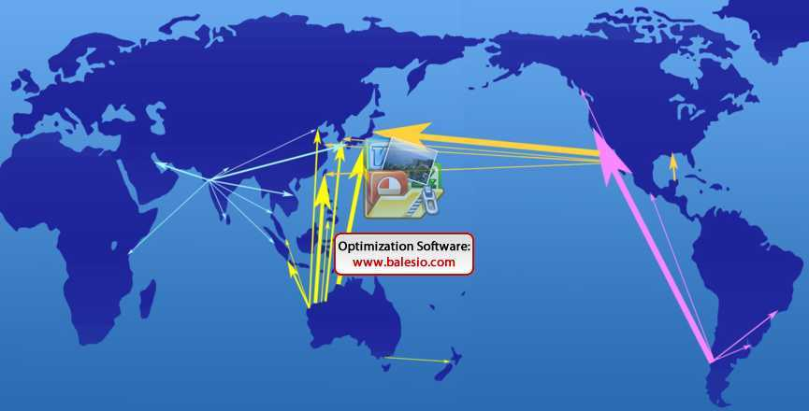
Salt Partners
Bulk Salt Trade in Asia-Pacific
Vladimir M. Sedivy
Salt Partners Ltd, Zurich, Switzerland
SALT PARTNERS

Slide 30
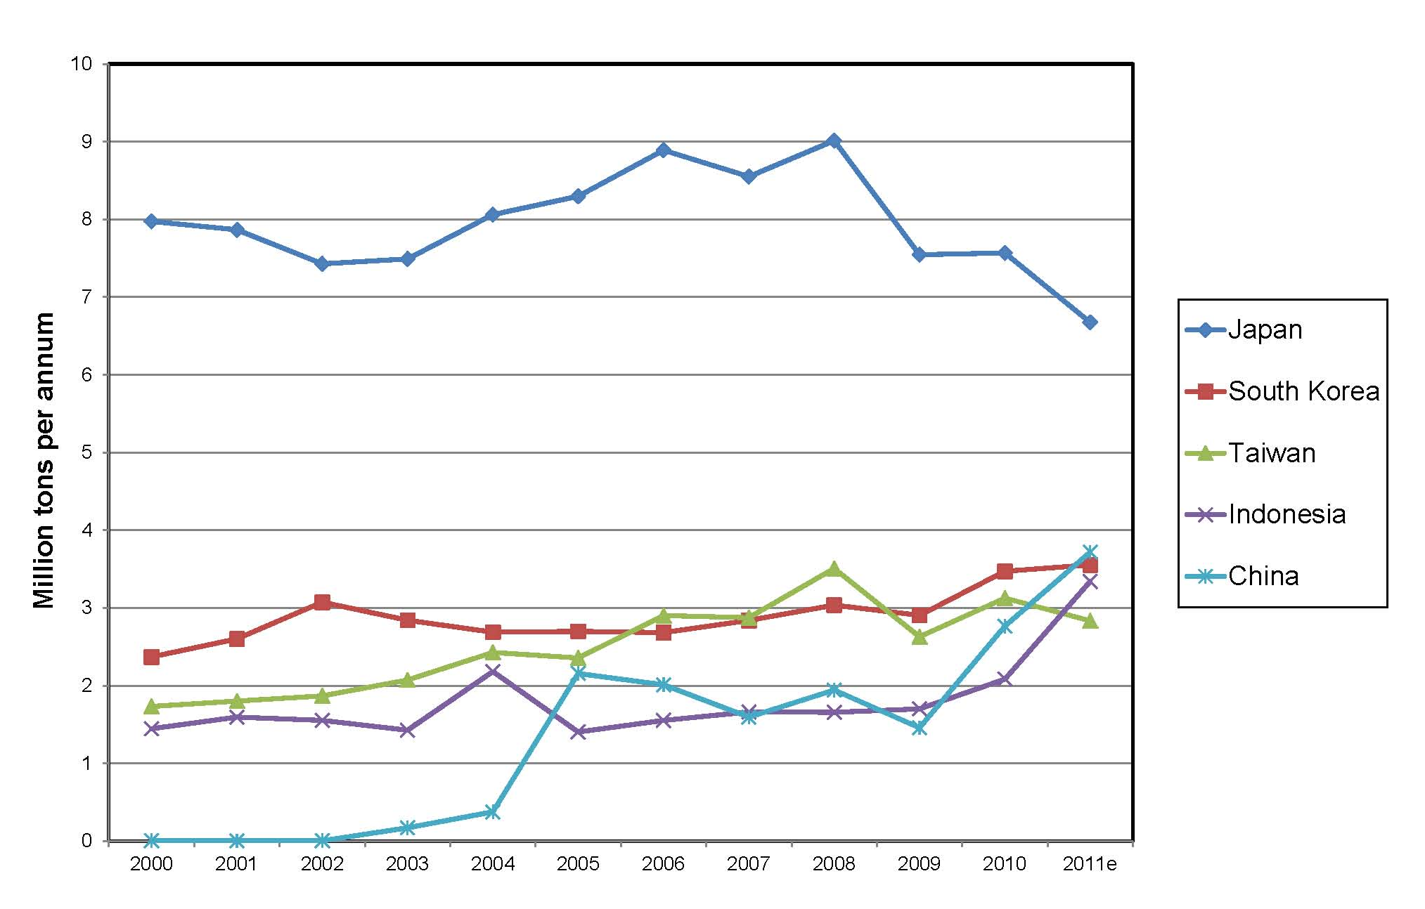
Salt Partners
Largest Salt Imports in Asia-Pacific
Salt imports of the five largest salt importers in Asia Pacific region. Since 2000, these countries have increased their salt imports by average 3.7% per annum.
Vladimir M. Sedivy
Salt Partners Ltd, Zurich, Switzerland
ROSKILL

Slide 31
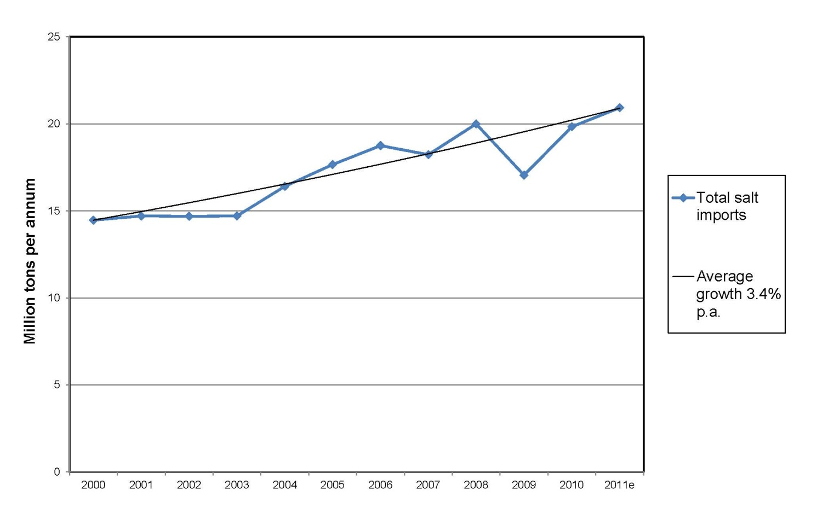
Salt Partners
Total Salt Imports in Asia-Pacific
Since 2000, salt imports of 11 largest salt importers in Asia Pacific region have risen by 6.5 million tonnes, equal to 45%, or equal to 3.4% per annum.
Vladimir M. Sedivy
Salt Partners Ltd, Zurich, Switzerland
ROSKILL

Slide 32
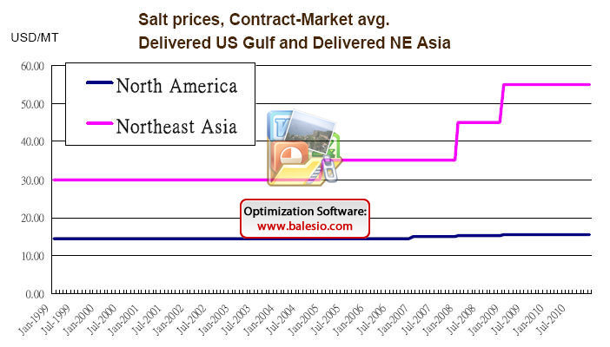
Salt Partners
Salt Prices in US Gulf and North East Asia
Since 2005, salt prices delivered in North East Asia-Pacific region have risen by USD 25 per ton, equal to 83%, or equal to 16% per annum.
Vladimir M. Sedivy
Salt Partners Ltd, Zurich, Switzerland
CMAI

Slide 33
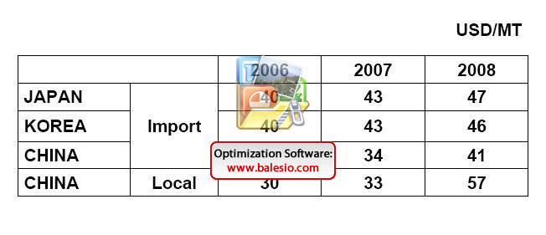
Salt Partners
Salt Prices in North East Asia
Since 2006, salt imports to Japan, Korea and China have risen by USD 6 - 7 per ton. In the meantime, the local salt prices in China have risen by USD 27 per ton.
Vladimir M. Sedivy
Salt Partners Ltd, Zurich, Switzerland
GTA

Slide 34
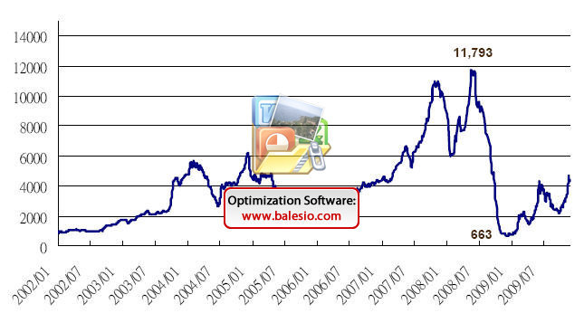
Salt Partners
Ocean Freight Cost Development since 2002
Since 2002, ocean freight cost measured by the Baltic Dry Index rose from 1000 to almost 12’000 in 2008, dropped to less than 700 and rose to it’s long term trend average of approx. 2’000 at present.
Vladimir M. Sedivy
Salt Partners Ltd, Zurich, Switzerland
GTA

Slide 35
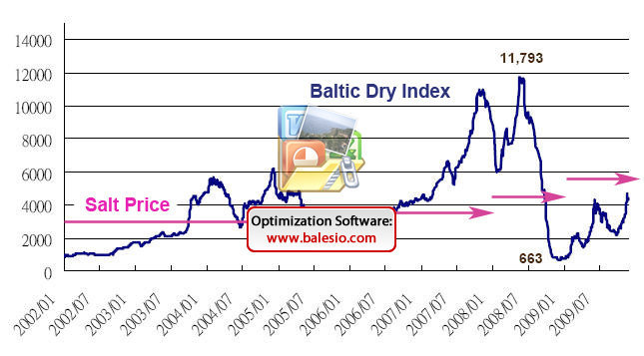
Salt Partners
Ocean Freight and Salt Price Development
Since 2002, delivered salt prices to North East Asia have been rising independently of the high ocean freight cost fluctuations.
Vladimir M. Sedivy
Salt Partners Ltd, Zurich, Switzerland
GTA

Slide 36
Salt Partners
Salt Supply Situation in other Regions
Indian salt quality is not up to the “Australian standard”
Due to shortage, Indian salt prices moved from INR 200/t to 800/t
In the south of Africa, salt stockpiles are depleted
Mexican salt production is at maximum and unlikely to expand
Chilean salt has limited acceptance in the chloralkali industry
Brazil is too far away from Asia-Pacific region
Vladimir M. Sedivy
Salt Partners Ltd, Zurich, Switzerland

Slide 37
Salt Partners
Conclusion
Insufficient salt on stockpiles in Australia, together with signs of limited salt availability elsewhere, indicates that the present high quality solar salt production capacity is insufficient.
The shortage is likely to accentuate when the present economic slowdown comes to an end and the high growth rates in the Asia-Pacific region are re-established.
Vladimir M. Sedivy
Salt Partners Ltd, Zurich, Switzerland

Slide 38
Salt Partners
Remedy Option No.1:
Compensate shortage with poor quality salt
This option is undesirable:
Impurities increase the cost of brine treatment in chloralkali plants
Poor quality salts cause excessive contaminated effluent discharge
Vladimir M. Sedivy
Salt Partners Ltd, Zurich, Switzerland

Slide 39
Salt Partners
General Cost of Salt and Impurity Removal
 | Cost of brine treatment and sludge disposal | Cost of salt, brine treatment and sludge disposal
 | (USD / t salt) | (USD / t salt)
Minimum | 1.50 | 10
Average | 10 | 25
Maximum | 30 | 50
Vladimir M. Sedivy
Salt Partners Ltd, Zurich, Switzerland
SALT PARTNERS AT GANDHIDHAM 2008 SALT CONFERENCE

Slide 40
Salt Partners
Remedy Option No. 2
Compensate shortage with vacuum salt
This option is undesirable:
Vacuum salt is expensive
Vacuum salt production is mostly energy inefficient
1 ton of CO₂ per ton of salt may emanate when burning black coal
Burning black coal frequently causes pollution
CO₂ in the atmosphere causes global warming and climatic change
Vladimir M. Sedivy
Salt Partners Ltd, Zurich, Switzerland

Slide 41
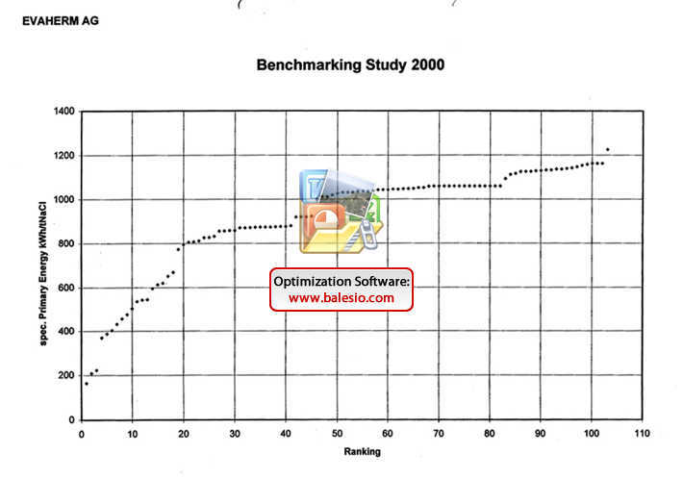
Salt Partners
Energy Consumption Benchmarking Study
96 out of 103 thermal salt evaporating plants use more than theoretical amount of energy.
Vladimir M. Sedivy
Salt Partners Ltd, Zurich, Switzerland
EVATHERM

Slide 42
Salt Partners
Air Pollution
Vladimir M. Sedivy
Salt Partners Ltd, Zurich, Switzerland
In China, black coal is burned to make steam for vacuum salt production.
WU HONG / EPA

Slide 43
Salt Partners
Global Warming
Vladimir M. Sedivy
Salt Partners Ltd, Zurich, Switzerland
Hurricane “Katrina” in the Gulf of Mexico on 29.8.2005.
NASA

Slide 44
Salt Partners
Destructive Climatic Change
Hurricane “Katrina” destroyed large parts of New Orleans and surroundings. Increased hurricane activity is believed to be caused by global warming.
Vladimir M. Sedivy
Salt Partners Ltd, Zurich, Switzerland
Groenteman

Slide 45
Salt Partners
Remedy Option No. 3
Compensate shortage with additional high quality solar salt production capacities
This option is highly desirable:
High quality solar salt is inexpensive
Solar salt production employs renewable energy most effectively
Solar saltfields are environmentally beneficial wetlands
Vladimir M. Sedivy
Salt Partners Ltd, Zurich, Switzerland

Slide 46
Salt Partners
Solar Energy on the Planet Earth
Locations with highest rates of evaporation, suitable for solar salt production: Caribbean Sea North Africa South Africa Middle East Western India Western Australia
In China, the Gulf of Bohai receives only half the solar energy available at the most suitable locations.
Vladimir M. Sedivy
Salt Partners Ltd, Zurich, Switzerland
NASA

Slide 47
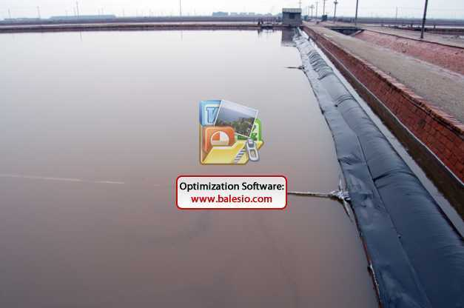
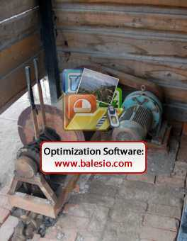
Salt Partners
Chinese Solar Salt Production Method
At the Gulf of Bohai, sudden rain storms are frequent and heavy. Saturated brine is being protected against dilution with plastic foils. The plastic is pulled over the brine, rain water is drained when the storm is over and the plastic foil is rolled back using electric motors.
Vladimir M. Sedivy
Salt Partners Ltd, Zurich, Switzerland
SALT PARTNERS

Slide 48
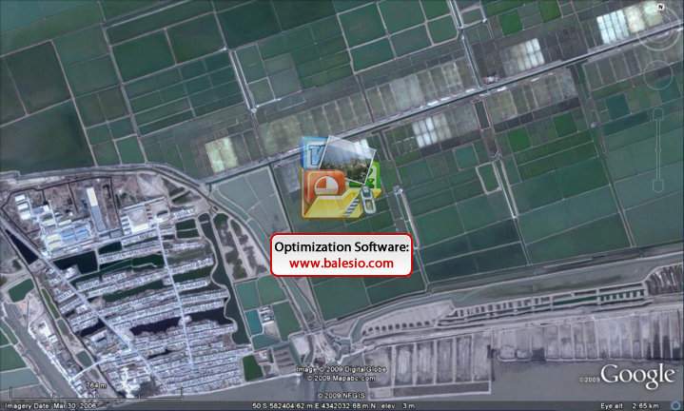
Salt Partners
Chinese Salt Production Method is Labour Intensive
Large workforce is required to live inside the saltworks to pull the plastic quickly, within an hour of the storm warning and drain the rain water when the storm is over. How long will the workforce be available at the present low cost?
Vladimir M. Sedivy
Salt Partners Ltd, Zurich, Switzerland

Slide 49
Salt Partners
Australian and Chinese Saltworks Productivity
Salt Producer | Production Capacity | Saltworks Area | Productivity
 | (t/y) | (km2) | (t/km2)
Shark Bay | 2’200’000 | 70 | 31’400
Onslow | 2’500’000 | 86 | 29’000
Dampier | 4’000’000 | 100 | 40’000
Port Headland | 3’500’000 | 92 | 38’300
Hangu Changlu | 1’000’000 | 135 | 7’400
Vladimir M. Sedivy
Salt Partners Ltd, Zurich, Switzerland
SALT PARTNERS

Slide 50
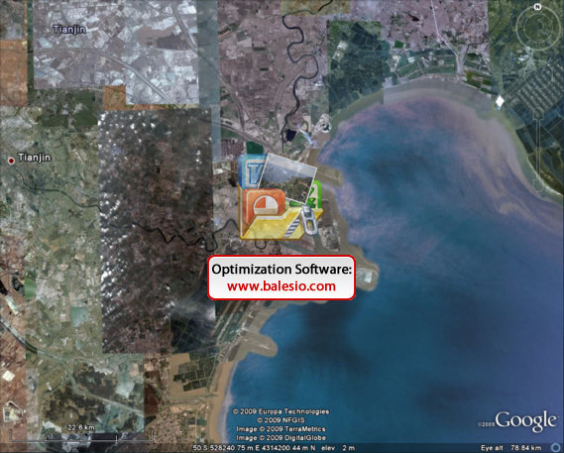
Salt Partners
Solar Salt Production in the North of Bohai Gulf
Two major Tianjin saltworks occupy approx. 400 km2 of land adjacent to the booming TEDA (Tanggu Economic Development Area).
To the north of TEDA, the Hangu Changlu Saltern produces 1’000’000 t/y of solar salt on135 km2 of land.
In the middle, one of the largest Chinese ports is being developed.
Saltworks land in the south of TEDA, next to the harbour, has already been converted to a coal storage (see the black spot).
TEDA
Vladimir M. Sedivy
Salt Partners Ltd, Zurich, Switzerland

Slide 51
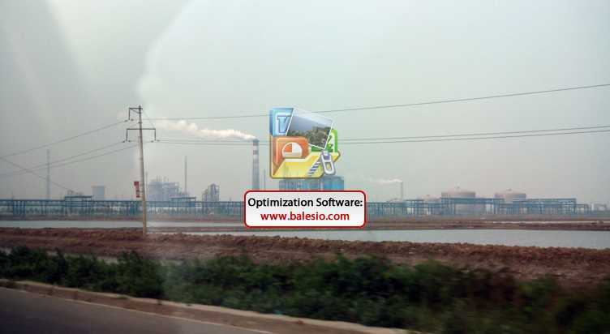
Salt Partners
Conversion of Solar Saltworks to Industrial Parks
Parts of the Hangu Changlu Saltern have already been converted to an industrial park.
Vladimir M. Sedivy
Salt Partners Ltd, Zurich, Switzerland
SALT PARTNERS

Slide 52
Salt Partners
Conclusion
Solar salt production in the Gulf of Bohai has a limited future potential:
Present production method is too labour intensive
Climatic conditions are unfavourable
Land is required for more productive use
High quality solar salt should be produced in more suitable regions more efficiently and imported to China.
Vladimir M. Sedivy
Salt Partners Ltd, Zurich, Switzerland

Slide 53
Salt Partners
Opportunity for Solar Salt Exports
Solar salt exports could fill the gap if:
Quality according to the “Australian standard”, i.e. less than 0.04% Ca, 0.02% Mg and 0.12% SO4 would consistently be achieved
Shipments in Panamax vessels would be possible
Ship loading rates of 2’000 t/h would be facilitated
Vladimir M. Sedivy
Salt Partners Ltd, Zurich, Switzerland

Slide 54
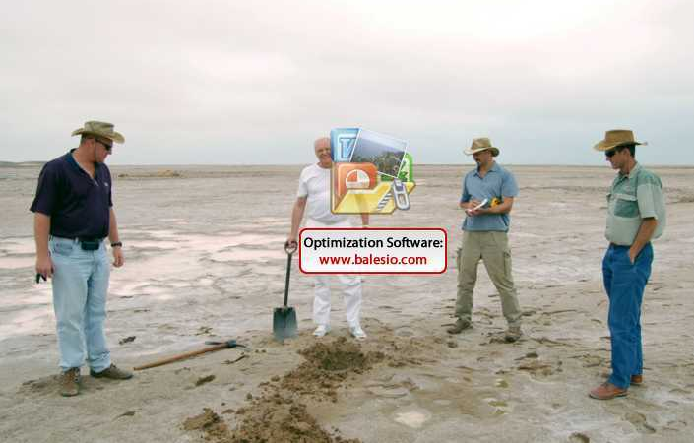
Salt Partners
Salt Partners Prospect New Solar Saltfields
Vladimir M. Sedivy
Salt Partners Ltd, Zurich, Switzerland
Salt Partners assist their clients to prospect sites where new solar saltfields could be established.
SALT PARTNERS

Slide 55
Salt Partners
Salt Partners supply technologies for production of salt according to “Australian standard”
Vladimir M. Sedivy
Salt Partners Ltd, Zurich, Switzerland
Modern industrial salt upgrading plant in Spain. Capacity 500 t/h solar salt

Slide 56
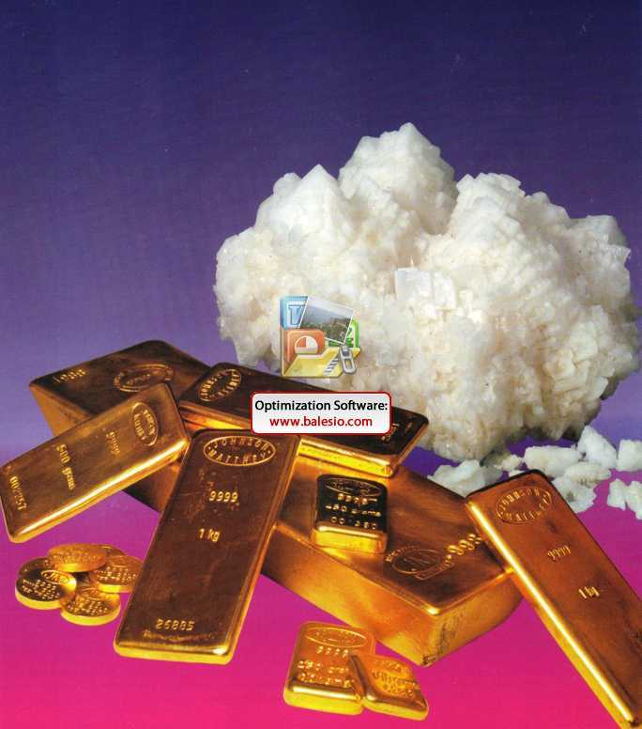
Salt Partners
Why not turn your salt into gold?
Vladimir M. Sedivy
Salt Partners Ltd, Zurich, Switzerland
SALT PARTNERS

